Slide 1
Use Case Diagram & Domain Model
Group Members:
M. Asad Bashir 4296-FBAS/BSSE/F-21(A)
M. Ammad Choudhary 4293-FBAS/BSSE/F-21(A)
Ali Hamza 4289-FBAS/BSSE/F-21(A)
Muneeb-ur-Rehman 4297-FBAS/BSSE/F-21(A)
Haseeb Ahmed 4301-FBAS/BSSE/F-21(A)

Slide 2
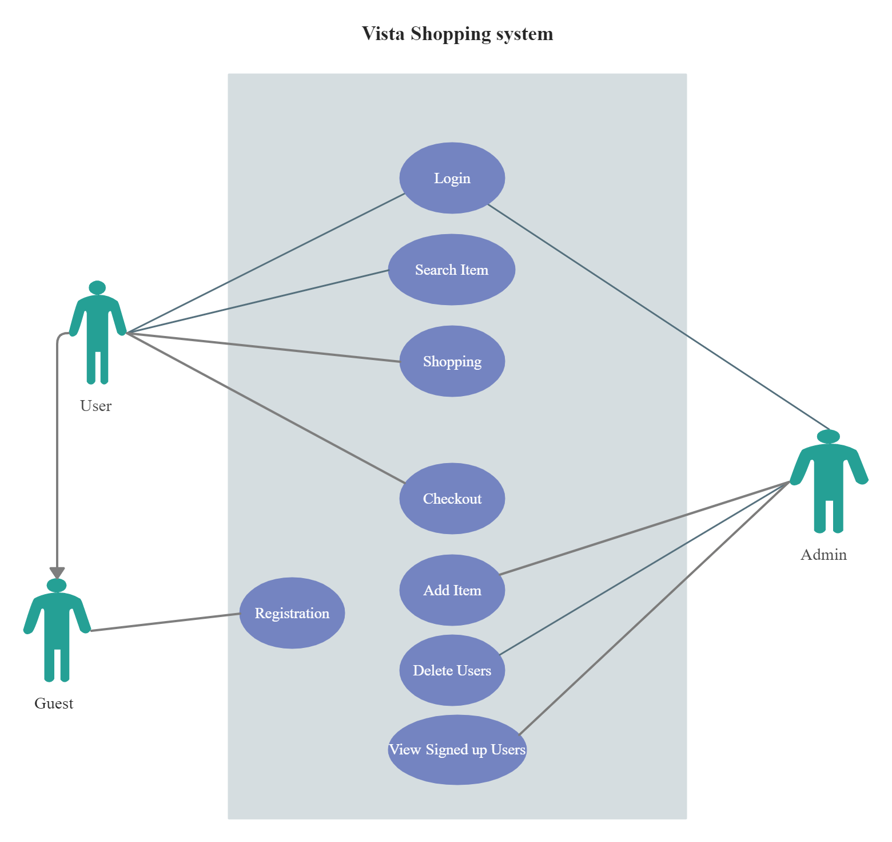
Use Case

Slide 3
Domain Model
User
Check-out
Username: string
Continue
Password: string
0 …*
1..*
Final Bill
Check-out and Pay: Boolean
Main Menu
Email Address: string
Categories
Phone Number: integer
1..*
in
1
Wishlist
Default Shipping Address: string
Search Items
Default Billing Address: string
My Account
Default Payment Method: integer
0..*
Shopping Cart
Login
Admin
Search products
Username: string
Add to cart
Password: string
0..*
Check-out
Order tracking
0..1
1
instructs
Stock Management
1
SKU: string
Product name: string
Stock availability: boolean
1..*
1..*
User Management
Delete User
View User
Add Product
Modify Product

